Slide 1
Home Care Pro Application
Mobile Application Development COM 437
Dustin Armstrong

Slide 2
Introduction
Background:
Mobile Applications COM 437 course focuses on designing and developing Android applications.
Purpose of the project:
To demonstrate the skills learned by creating a working Android application.
Scope of the project:
Eight weeks to complete a functional Android application

Slide 3
Project Description
Overview of the project:
An Android application for tracking home maintenance tasks, including creating lists, reminders, and tracking completed tasks.
Objectives of the project:
Efficient and effective management of home maintenance tasks.
Target Audience:
Homeowners and property managers seeking a solution to track home maintenance requirements.
Benefits of the project:
Resource for creating tasks, setting reminders, and tracking completion status.

Slide 4
Problem Addressing
Identification of the problem:
Lack of awareness and knowledge about essential maintenance tasks and their frequency.
Cause of the problem:
Lack of awareness and understanding of the importance of specific tasks and their frequency.
Impact of the problem:
Unsafe conditions, costly repairs, and reduced property value due to neglected maintenance.

Slide 5
Platform
Selection of platform:
Android operating system, compatible with smartphones and tablets running Android 6.0 or higher.
Explanation of the platform:
Android is widely supported, and version 6.0 or higher is commonly used.
Advantages of the platform:
Access to Google services, developer support, and a large Android developer community.

Slide 6
Front/Back End Support
Selection of front-end technology:
Java and Android Studio for developing the user interface.
Selection of back-end technology:
SQLite for supporting the back-end database.

Slide 7
Functionality
List of features and functionalities:
Create and manage a list of maintenance tasks with name, description, and frequency.
Set assignment reminders based on selected frequencies (daily, weekly, monthly, yearly).
Track completed tasks and provide a history of completed tasks.
Dashboard showing a summary of completed, upcoming, and overdue tasks.
Push notifications to alert users of upcoming and late maintenance requirements.

Slide 8
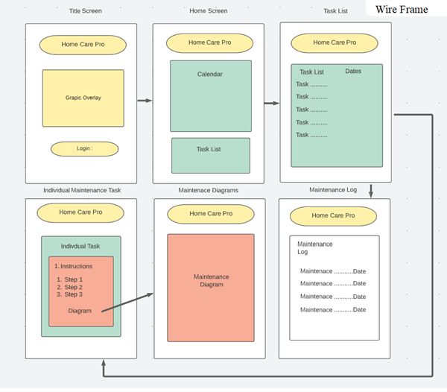
Design/Wireframe
Home Screen: Displays the list of maintenance tasks and their status.
Task List: Allows users to view existing tasks.
Individual Task: Shows details of a selected task.
Diagram Screen: Displays maintenance diagrams.
Maintenance Log: Summarizes completed, upcoming, and overdue tasks.

Slide 9
Conclusion
Recap of the project:
The application provides a simple and user-friendly design for efficient management of home maintenance tasks.
Future developments and enhancements:
Potential for cross-platform scheduling.

Slide 10
References:
Studio & App Tools. Android Developers. (n.d.). Retrieved April 14, 2023, from https://developer.android.com/studio?
Realm.io MongoDB. (n.d.). How to build an Android app. Realm.io. Retrieved April 14, 2023, from https://realm.io/building-android-app
Space Technologies.com Patel, B. (2023, April 6). How to build an Android app in 2023 [8 steps guide + faqs]. How To Build an Android Appl. Retrieved April 14, 2023, from https://www.spaceotechnologies.com/blog/how-to-build-an-android-app/
Android Developers. (2023). Android Courses. Retrieved from https://developer.android.com/courses?gclid=Cj0KCQjwmN2iBhCrARIsAG_G2i7ivUVtd4weite26Z6Zhr1s5aqnFVg2NlgZB8c4lXHpFcgg4nbrvKEaAhYrEALw_wcB&gclsrc=aw.ds"

